Slide 1
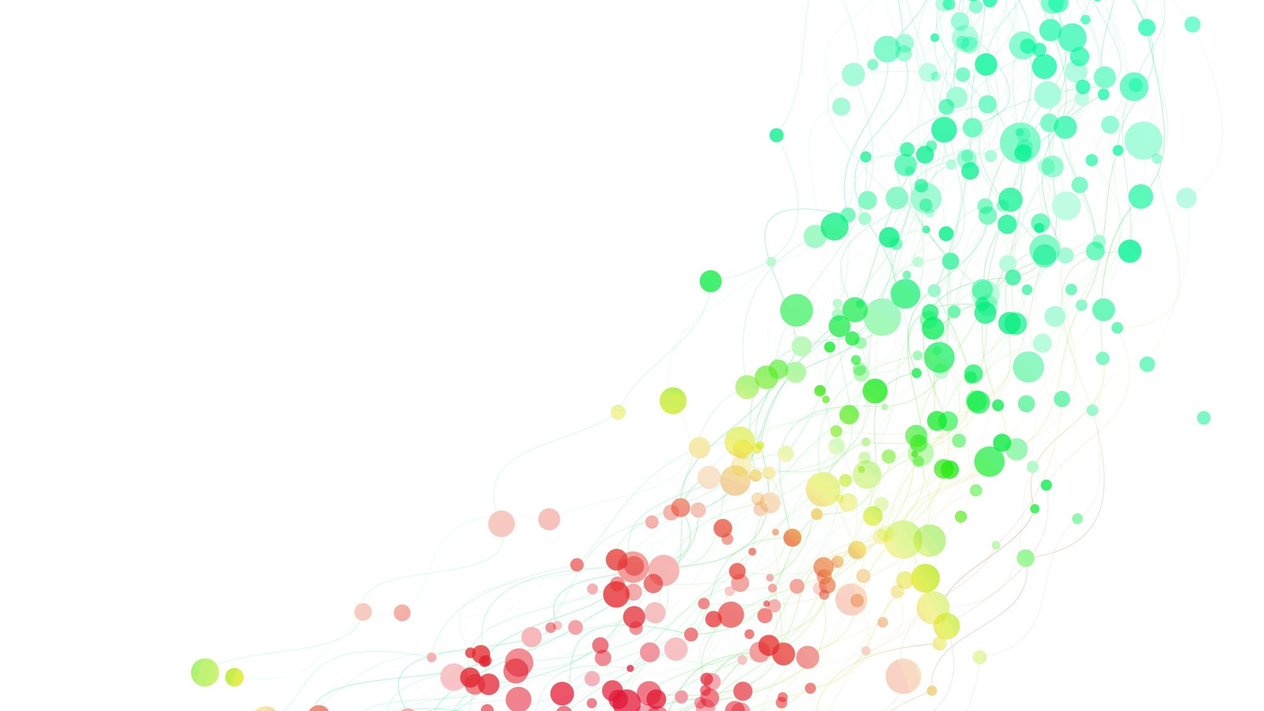
Predictive Modeling for Disease Diagnosis

Slide 2

INTRODUCTION
The objective of this project is to develop a predictive model that can accurately classify individuals into
diseased or non-diseased categories based on their health attributes. By leveraging machine learning
algorithms, we aim to create a reliable tool that healthcare providers can use to assist in disease
diagnosis and prognosis.

Slide 3

PREPROCESSING
1 : Data Cleaning: Check if there null and remove it
2 : Data Scaling: Min Max Scalar for Data
3 : Divide To Dependant And Independent Variables
4 : Divide data to train data and test data

Slide 4

MODEL
Built a Knn Model With 23 K
Fit Training data to model
Prediction Model with test data

Slide 5

Metrics
Accuracy score 1.0
Precision score 1.0
Recall Score 1.0
Ft1 Score 1.0

Slide 6

OUTCOMES
The ultimate goal is to develop a robust predictive model that can assist healthcare professionals in
early disease detection and patient management. By accurately identifying individuals at risk of certain
diseases, interventions can be initiated promptly, potentially improving patient outcomes and reducing
healthcare costs.

